Slide 1
MICT 2201: Artificial Intelligence
Instructor: M. Shamim Kaiser
Email: Kaiser@juniv.edu
Text phone: 01511932323

Slide 2
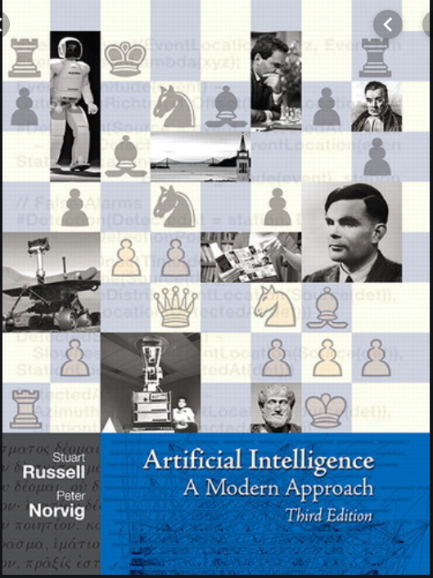
Text Book

Slide 3
Topics
This course covers six major topics
Search (Chapter 3, 5, 6)
Knowledge Representation & Inference (Chapter 8, 9)
Expert System
Fuzzy Logic
ANN
Genetic Algorithm

Slide 4
Grading
Final 50%
Lessons from the Mid will not be asked in the final.
Class Test 20%
Best 3 will be counted out of 4/5
Assignment 10%
3 assignment will be given, you will receive zero after the deadline
Mid 20%
No missed make up will be arranged
Attendance 10%
BUP policy will be followed strictly

Slide 5
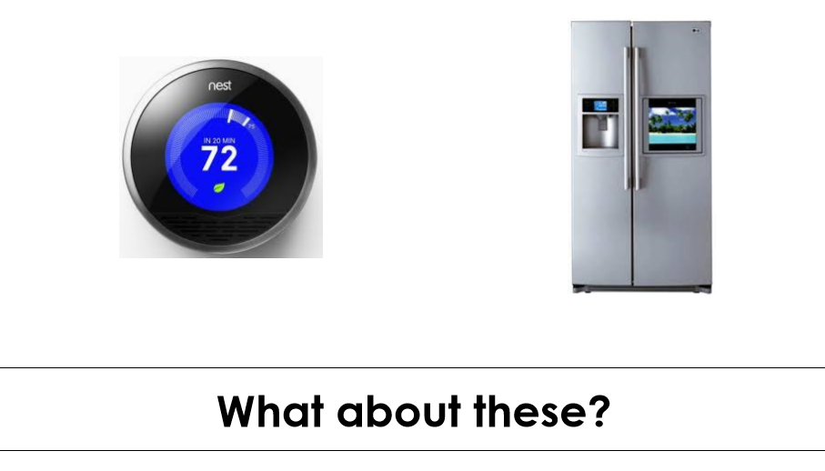
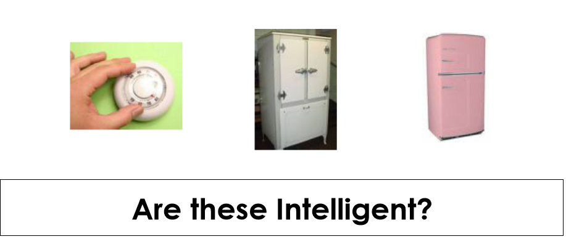
What is AI?
Artificial intelligence refers to machine's intelligence, unlike the natural intelligence displayed by humans and animals, which involves consciousness and emotionality.

Slide 6
What is AI?
A branch of Computer Science.
Examines how we can achieve intelligent behaviour through computation.
The deﬁnitions on
top are concerned with thought processes and reasoning,
whereas the ones on the bottom address behavior.
the left measure success in terms of ﬁdelity to human performance,
whereas the ones on the right measure against an ideal performance measure, called rationality.
A RATIONALITY system is rational if it does the “right thing,” given what it knows.

Slide 7
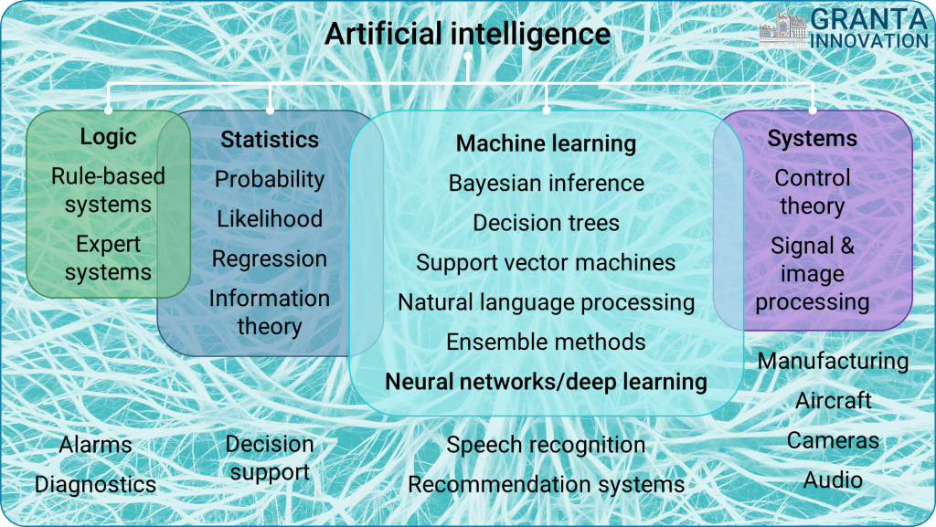
What is AI?

Slide 8
Human vs Artificial Intelligence
In general, there are various reasons why trying to mimic humans might not be the best approach to AI: – Computers and Humans have a very different architecture with quite different abilities. – Numerical computations – Visual and sensory processing – Massively and slow parallel vs. fast serial

Slide 9
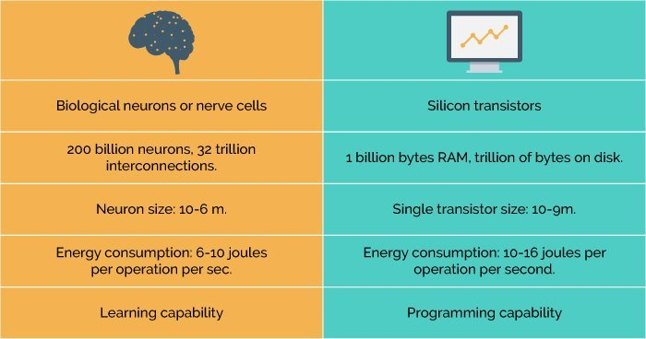

Slide 10
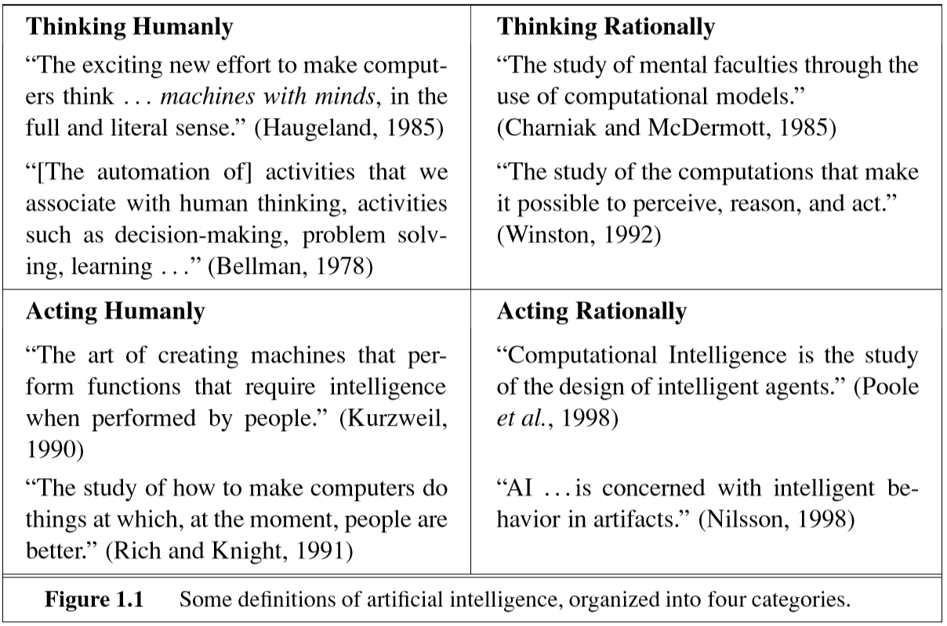
AI

Slide 11
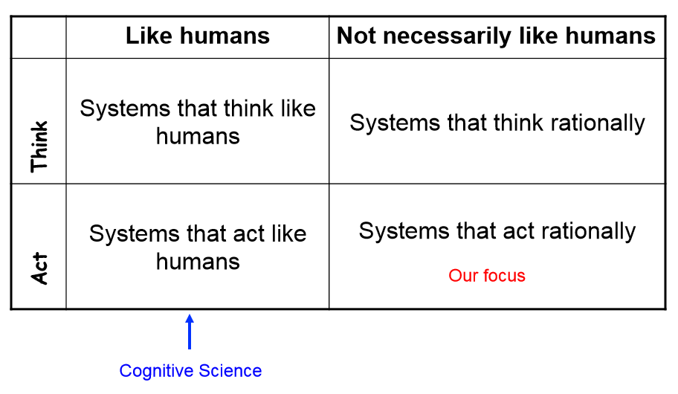
Four AI Definitions by Russell + Norvig

Slide 12
Thinking Humanly
Determine how humans think, and attempt to replicate it in software/hardware
Develop a theory of the human mind, by one or more of
Introspection (self analysis--the examination of one's own conscious thoughts and feelings)
Psychological experiments (top-down?)
Brain imaging (bottom-up?)
What level of abstraction is best?
“Knowledge” or “circuits”?
Should we model the “mind” or the “brain”?

Slide 13
Thinking Humanly(Cont.)
And how would we validate such a system? e.g. the General Problem Solver (GPS): Attempted to “solve like a human”

Slide 14

Acting Humanly
Intelligence = the ability to act indistinguishably from a human in cognitive tasks(?)
An operational test: the Turing Test [Alan Turing 1950]
H interrogates X in a black box
If X is a computer, but H cannot tell, X must be intelligent!
Loebner Prize: http://www.loebner.net/Prizef/loebnerprize.html

Slide 15
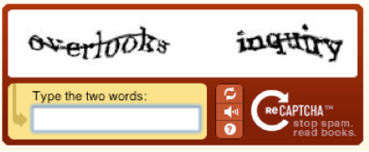
Acting humanly: The Turing Test approach
Turing test is proposed by Alan Turing (1950).
It provides a satisfactory TURING TEST operational deﬁnition of intelligence.
A computer passes the test if a human interrogator, after posing some written questions, cannot tell whether the written responses come from a person or from a computer.
For now, we note that programming a computer to pass a rigorously applied test provides plenty to work on
Weak Turing type tests:

Slide 16
Thinking Rationally
Codify “laws of thought” or “right-thinking”
– Irrefutable reasoning processes
– Independent of what humans do
All men are mortal
Socrates is a man
Therefore Socrates is mortal
Problems include
– Difficulty in codifying informal knowledge
– Difficulty in dealing with uncertainty
– Scalability issues

Slide 17
Acting Rationally
Act in such a way as to achieve goals, given beliefs
Define an agent, and give it
– Some goals
– The ability to perceive its surroundings
– The ability to perform actions
– The ability to “reason”
It will (try to) find actions to achieve the goals
Note that this doesn’t necessarily involve “thinking” – e.g. is a thermostat intelligent?

Slide 18
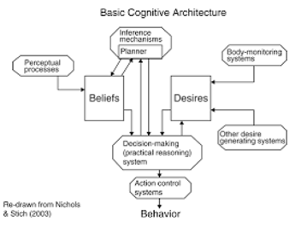
This gives us an engineering viewpoint
– Can we develop systems that do useful stuff?
– Or even cool stuff!?

Slide 19
Agent
An agent
Perceives its environment through sensors
Acts on its environment through effectors
An agent can be:
Human-Agent: A human agent has eyes, ears, and other organs which work for sensors and hand, legs, vocal tract work for actuators.
Robotic Agent: A robotic agent can have cameras, infrared range finder, NLP for sensors and various motors for actuators.
Software Agent: Software agent can have keystrokes, file contents as sensory input and act on those inputs and display output on the screen.

Slide 20
Hence the world around us is full of agents such as thermostat, cellphone, camera, and even we are also agents.
Before moving forward, we should first know about sensors, effectors, and actuators.
Sensor: Sensor is a device which detects the change in the environment and sends the information to other electronic devices. An agent observes its environment through sensors.
Actuators: Actuators are the component of machines that converts energy into motion. The actuators are only responsible for moving and controlling a system. An actuator can be an electric motor, gears, rails, etc.
Effectors: Effectors are the devices which affect the environment. Effectors can be legs, wheels, arms, fingers, wings, fins, and display screen.

Slide 21
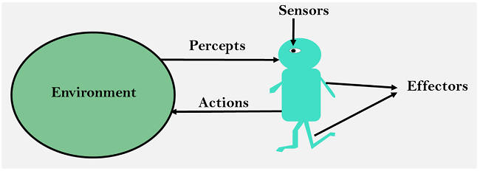

Slide 22
Intelligent Agents:
An intelligent agent is an autonomous entity which act upon an environment using sensors and actuators for achieving goals. An intelligent agent may learn from the environment to achieve their goals. A thermostat is an example of an intelligent agent.
Following are the main four rules for an AI agent:
Rule 1: An AI agent must have the ability to perceive the environment.
Rule 2: The observation must be used to make decisions.
Rule 3: Decision should result in an action.
Rule 4: The action taken by an AI agent must be a rational action.

Slide 23
Rational Agents
A rational agent tries to “do the right thing” wrt a set of goals or utilities
The right thing can be specified by a performance measure defining a numerical value for any environment history
A rational action is whatever action maximises the expected value of the performance measure, given the current state of the environment and the percept sequence to date
But note that
Rational ≠ Omniscient (all knowing),
Rational ≠ Clairvoyant (Tell anything),
Rational ≠ Successful

Slide 24
Rational Agents
It is entirely possible to do the right thing and to fail anyway
Sometimes randomness is the most rational choice! – e.g. games
An agent’s behaviour is specified by an agent function mapping perceptsequences to actions
The agent will usually also store knowledge or rules that help it to understand and to select actions • We will discuss four basic types of agents, in order of generality

Slide 25
Structure of an AI Agent
The task of AI is to design an agent program which implements the agent function. The structure of an intelligent agent is a combination of architecture and agent program. It can be viewed as:
Agent = Architecture + Agent program
Following are the main three terms involved in the structure of an AI agent:
Architecture: Architecture is machinery that an AI agent executes on.
Agent Function: Agent function is used to map a percept to an action.
f:P* → A
Agent program: Agent program is an implementation of agent function. An agent program executes on the physical architecture to produce function f.

Slide 26
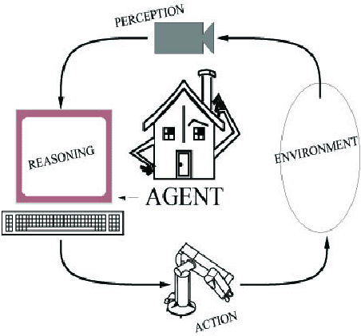
Components of an AI System
An agent perceives its environment
through sensors and acts on the
environment through actuators.
Human: sensors are eyes, ears,
actuators (effectors) are hands,
legs, mouth.
Robot: sensors are cameras, sonar,
lasers, ladar, bump, effectors are
grippers, manipulators, motors
The agent’s behavior is described by its
function that maps percept to action.

Slide 27
Foundations of AI
Philosophy
450 BC, Socrates asked for algorithm to distinguish pious from non-pious individuals
Aristotle developed laws for reasoning
Mathematics
1847, Boole introduced formal language for making logical inference
Economics
1776, Smith views economies as consisting of agents maximizing their own well being (payoff)
Neuroscience
1861, Study how brains process information
Psychology
1879, Cognitive psychology initiated
Linguistics
1957, Skinner studied behaviorist approach to language learning

Slide 28
PEAS Representation
PEAS is a type of model on which an AI agent works upon. When we define an AI agent or rational agent, then we can group its properties under PEAS representation model. It is made up of four words:
P: Performance measure
E: Environment
A: Actuators
S: Sensors
Example: Taxi driver
Performance measure: safe, fast, comfortable (maximize profits)
Environment: roads, other traffic, pedestrians, customers
Actuators: steering, accelerator, brake, signal, horn
Sensors: cameras, sonar, speedometer, GPS, odometer, accelerometer, engine sensors

Slide 29
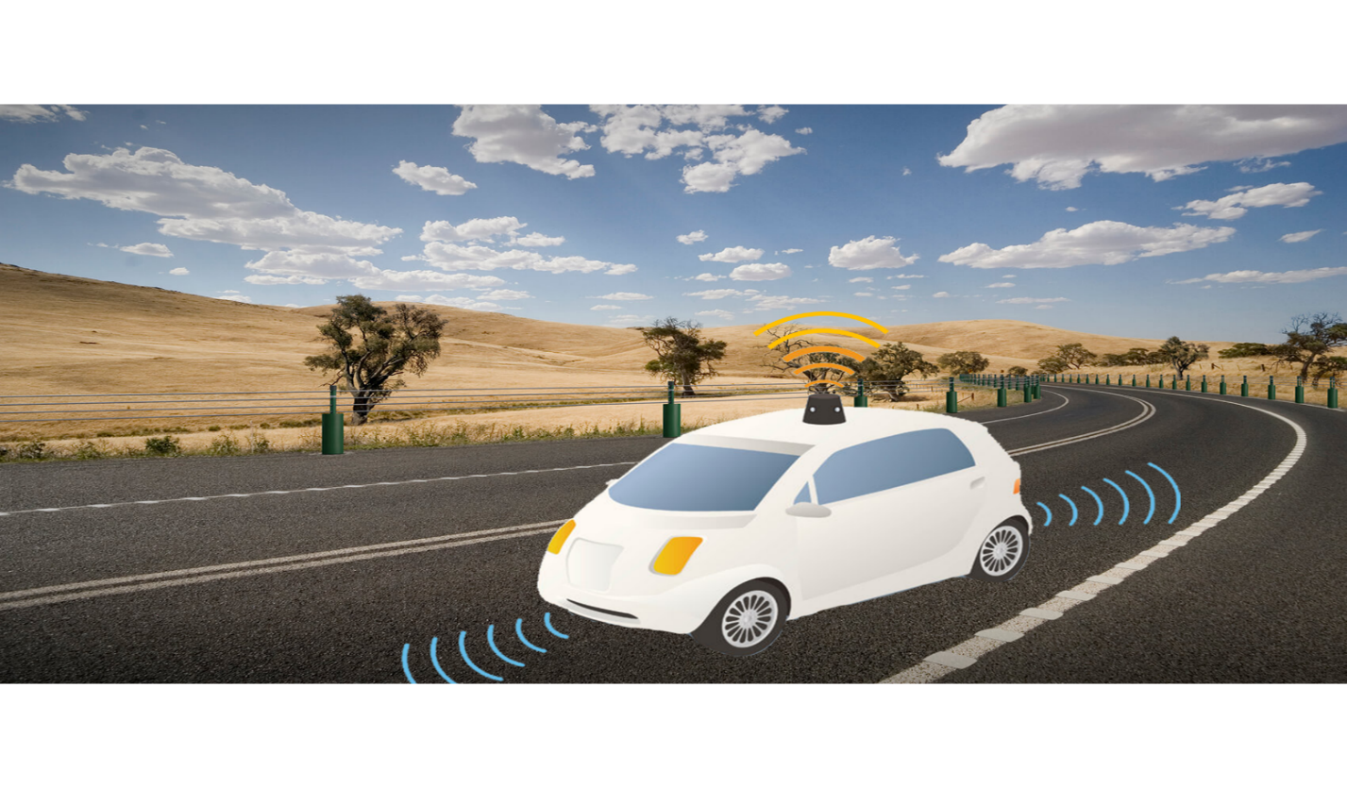
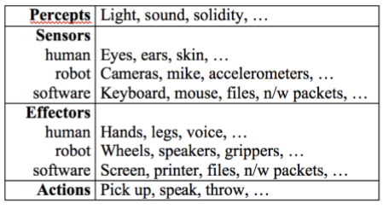

Slide 30
Environment Properties
Fully observable vs. partially observable
Deterministic vs. stochastic / strategic
Episodic vs. sequential
Static vs. dynamic
Discrete vs. continuous
Single agent vs. multiagent

Slide 31
Agent Environment in AI
An environment is everything in the world which surrounds the agent, but it is not a part of an agent itself. An environment can be described as a situation in which an agent is present.
The environment is where agent lives, operate and provide the agent with something to sense and act upon it. An environment is mostly said to be non-feministic.

Slide 32
As per Russell and Norvig, an environment can have various features from the point of view of an agent:
Fully observable vs Partially Observable
Static vs Dynamic
Discrete vs Continuous
Deterministic vs Stochastic
Single-agent vs Multi-agent
Episodic vs sequential
Known vs Unknown
Accessible vs Inaccessible

Slide 33
Fully observable vs Partially Observable:
If an agent sensor can sense or access the complete state of an environment at each point of time then it is a fully observable environment, else it is partially observable.
A fully observable environment is easy as there is no need to maintain the internal state to keep track history of the world.
An agent with no sensors in all environments then such an environment is called as unobservable.
Deterministic vs Stochastic:
If an agent's current state and selected action can completely determine the next state of the environment, then such environment is called a deterministic environment.
A stochastic environment is random in nature and cannot be determined completely by an agent.
In a deterministic, fully observable environment, agent does not need to worry about uncertainty.

Slide 34
Episodic vs Sequential:
In an episodic environment, there is a series of one-shot actions, and only the current percept is required for the action.
However, in Sequential environment, an agent requires memory of past actions to determine the next best actions.
4. Single-agent vs Multi-agent
If only one agent is involved in an environment, and operating by itself then such an environment is called single agent environment.
However, if multiple agents are operating in an environment, then such an environment is called a multi-agent environment.
The agent design problems in the multi-agent environment are different from single agent environment.

Slide 35
Static vs Dynamic:
If the environment can change itself while an agent is deliberating then such environment is called a dynamic environment else it is called a static environment.
Static environments are easy to deal because an agent does not need to continue looking at the world while deciding for an action.
However for dynamic environment, agents need to keep looking at the world at each action.
Taxi driving is an example of a dynamic environment whereas Crossword puzzles are an example of a static environment.

Slide 36
Discrete vs Continuous:
If in an environment there are a finite number of percepts and actions that can be performed within it, then such an environment is called a discrete environment else it is called continuous environment.
A chess gamecomes under discrete environment as there is a finite number of moves that can be performed.
A self-driving car is an example of a continuous environment.

Slide 37
Known vs Unknown
Known and unknown are not actually a feature of an environment, but it is an agent's state of knowledge to perform an action.
In a known environment, the results for all actions are known to the agent. While in unknown environment, agent needs to learn how it works in order to perform an action.
It is quite possible that a known environment to be partially observable and an Unknown environment to be fully observable.

Slide 38
Accessible vs Inaccessible
If an agent can obtain complete and accurate information about the state's environment, then such an environment is called an Accessible environment else it is called inaccessible.
An empty room whose state can be defined by its temperature is an example of an accessible environment.
Information about an event on earth is an example of Inaccessible environment.

Slide 39
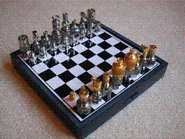
Environment Examples
Environment | Observable | Deterministic | Episodic | Static | Discrete | Agents
Chess with a clock
Chess without a clock
Fully observable vs. partially observable
Deterministic vs. stochastic / strategic
Episodic vs. sequential
Static vs. dynamic
Discrete vs. continuous
Single agent vs. multiagent
Fully observable vs. partially observable
Deterministic vs. stochastic / strategic
Episodic vs. sequential
Static vs. dynamic
Discrete vs. continuous
Single agent vs. multiagent

Slide 40
Environment Examples
Environment | Observable | Deterministic | Episodic | Static | Discrete | Agents
Chess with a clock | Fully | Strategic | Sequential | Semi | Discrete | Multi
Chess without a clock | Fully | Strategic | Sequential | Static | Discrete | Multi
Fully observable vs. partially observable
Deterministic vs. stochastic / strategic
Episodic vs. sequential
Static vs. dynamic
Discrete vs. continuous
Single agent vs. multiagent

Slide 41

Environment Examples
Environment | Observable | Deterministic | Episodic | Static | Discrete | Agents
Chess with a clock | Fully | Strategic | Sequential | Semi | Discrete | Multi
Chess without a clock | Fully | Strategic | Sequential | Static | Discrete | Multi
Poker
Fully observable vs. partially observable
Deterministic vs. stochastic / strategic
Episodic vs. sequential
Static vs. dynamic
Discrete vs. continuous
Single agent vs. multiagent

Slide 42
Environment Examples
Environment | Observable | Deterministic | Episodic | Static | Discrete | Agents
Chess with a clock | Fully | Strategic | Sequential | Semi | Discrete | Multi
Chess without a clock | Fully | Strategic | Sequential | Static | Discrete | Multi
Poker | Partial | Strategic | Sequential | Static | Discrete | Multi
Fully observable vs. partially observable
Deterministic vs. stochastic / strategic
Episodic vs. sequential
Static vs. dynamic
Discrete vs. continuous
Single agent vs. multiagent

Slide 43
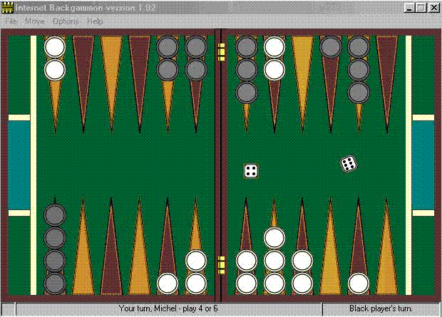
Environment Examples
Environment | Observable | Deterministic | Episodic | Static | Discrete | Agents
Chess with a clock | Fully | Strategic | Sequential | Semi | Discrete | Multi
Chess without a clock | Fully | Strategic | Sequential | Static | Discrete | Multi
Poker | Partial | Strategic | Sequential | Static | Discrete | Multi
Backgammon
Fully observable vs. partially observable
Deterministic vs. stochastic / strategic
Episodic vs. sequential
Static vs. dynamic
Discrete vs. continuous
Single agent vs. multiagent

Slide 44
Environment Examples
Environment | Observable | Deterministic | Episodic | Static | Discrete | Agents
Chess with a clock | Fully | Strategic | Sequential | Semi | Discrete | Multi
Chess without a clock | Fully | Strategic | Sequential | Static | Discrete | Multi
Poker | Partial | Strategic | Sequential | Static | Discrete | Multi
Backgammon | Fully | Stochastic | Sequential | Static | Discrete | Multi
Fully observable vs. partially observable
Deterministic vs. stochastic / strategic
Episodic vs. sequential
Static vs. dynamic
Discrete vs. continuous
Single agent vs. multiagent

Slide 45
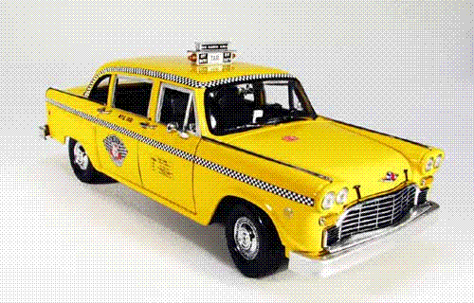
Environment Examples
Environment | Observable | Deterministic | Episodic | Static | Discrete | Agents
Chess with a clock | Fully | Strategic | Sequential | Semi | Discrete | Multi
Chess without a clock | Fully | Strategic | Sequential | Static | Discrete | Multi
Poker | Partial | Strategic | Sequential | Static | Discrete | Multi
Backgammon | Fully | Stochastic | Sequential | Static | Discrete | Multi
Taxi driving | Partial | Stochastic | Sequential | Dynamic | Continuous | Multi
Fully observable vs. partially observable
Deterministic vs. stochastic / strategic
Episodic vs. sequential
Static vs. dynamic
Discrete vs. continuous
Single agent vs. multiagent

Slide 46

Environment Examples
Environment | Observable | Deterministic | Episodic | Static | Discrete | Agents
Chess with a clock | Fully | Strategic | Sequential | Semi | Discrete | Multi
Chess without a clock | Fully | Strategic | Sequential | Static | Discrete | Multi
Poker | Partial | Strategic | Sequential | Static | Discrete | Multi
Backgammon | Fully | Stochastic | Sequential | Static | Discrete | Multi
Taxi driving | Partial | Stochastic | Sequential | Dynamic | Continuous | Multi
Medical diagnosis
Fully observable vs. partially observable
Deterministic vs. stochastic / strategic
Episodic vs. sequential
Static vs. dynamic
Discrete vs. continuous
Single agent vs. multiagent

Slide 47
Environment Examples
Environment | Observable | Deterministic | Episodic | Static | Discrete | Agents
Chess with a clock | Fully | Strategic | Sequential | Semi | Discrete | Multi
Chess without a clock | Fully | Strategic | Sequential | Static | Discrete | Multi
Poker | Partial | Strategic | Sequential | Static | Discrete | Multi
Backgammon | Fully | Stochastic | Sequential | Static | Discrete | Multi
Taxi driving | Partial | Stochastic | Sequential | Dynamic | Continuous | Multi
Medical diagnosis | Partial | Stochastic | Episodic | Static | Continuous | Single
Fully observable vs. partially observable
Deterministic vs. stochastic / strategic
Episodic vs. sequential
Static vs. dynamic
Discrete vs. continuous
Single agent vs. multiagent

Slide 48
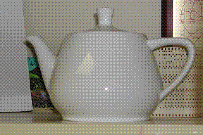
Environment Examples
Environment | Observable | Deterministic | Episodic | Static | Discrete | Agents
Chess with a clock | Fully | Strategic | Sequential | Semi | Discrete | Multi
Chess without a clock | Fully | Strategic | Sequential | Static | Discrete | Multi
Poker | Partial | Strategic | Sequential | Static | Discrete | Multi
Backgammon | Fully | Stochastic | Sequential | Static | Discrete | Multi
Taxi driving | Partial | Stochastic | Sequential | Dynamic | Continuous | Multi
Medical diagnosis | Partial | Stochastic | Episodic | Static | Continuous | Single
Image analysis
Fully observable vs. partially observable
Deterministic vs. stochastic / strategic
Episodic vs. sequential
Static vs. dynamic
Discrete vs. continuous
Single agent vs. multiagent

Slide 49
Environment Examples
Environment | Observable | Deterministic | Episodic | Static | Discrete | Agents
Chess with a clock | Fully | Strategic | Sequential | Semi | Discrete | Multi
Chess without a clock | Fully | Strategic | Sequential | Static | Discrete | Multi
Poker | Partial | Strategic | Sequential | Static | Discrete | Multi
Backgammon | Fully | Stochastic | Sequential | Static | Discrete | Multi
Taxi driving | Partial | Stochastic | Sequential | Dynamic | Continuous | Multi
Medical diagnosis | Partial | Stochastic | Episodic | Static | Continuous | Single
Image analysis | Fully | Deterministic | Episodic | Semi | Discrete | Single
Fully observable vs. partially observable
Deterministic vs. stochastic / strategic
Episodic vs. sequential
Static vs. dynamic
Discrete vs. continuous
Single agent vs. multiagent

Slide 50
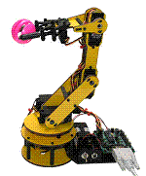
Environment Examples
Environment | Observable | Deterministic | Episodic | Static | Discrete | Agents
Chess with a clock | Fully | Strategic | Sequential | Semi | Discrete | Multi
Chess without a clock | Fully | Strategic | Sequential | Static | Discrete | Multi
Poker | Partial | Strategic | Sequential | Static | Discrete | Multi
Backgammon | Fully | Stochastic | Sequential | Static | Discrete | Multi
Taxi driving | Partial | Stochastic | Sequential | Dynamic | Continuous | Multi
Medical diagnosis | Partial | Stochastic | Episodic | Static | Continuous | Single
Image analysis | Fully | Deterministic | Episodic | Semi | Discrete | Single
Robot part picking
Fully observable vs. partially observable
Deterministic vs. stochastic / strategic
Episodic vs. sequential
Static vs. dynamic
Discrete vs. continuous
Single agent vs. multiagent

Slide 51
Environment Examples
Environment | Observable | Deterministic | Episodic | Static | Discrete | Agents
Chess with a clock | Fully | Strategic | Sequential | Semi | Discrete | Multi
Chess without a clock | Fully | Strategic | Sequential | Static | Discrete | Multi
Poker | Partial | Strategic | Sequential | Static | Discrete | Multi
Backgammon | Fully | Stochastic | Sequential | Static | Discrete | Multi
Taxi driving | Partial | Stochastic | Sequential | Dynamic | Continuous | Multi
Medical diagnosis | Partial | Stochastic | Episodic | Static | Continuous | Single
Image analysis | Fully | Deterministic | Episodic | Semi | Discrete | Single
Robot part picking | Fully | Deterministic | Episodic | Semi | Discrete | Single
Fully observable vs. partially observable
Deterministic vs. stochastic / strategic
Episodic vs. sequential
Static vs. dynamic
Discrete vs. continuous
Single agent vs. multiagent

Slide 52

Environment Examples
Environment | Observable | Deterministic | Episodic | Static | Discrete | Agents
Chess with a clock | Fully | Strategic | Sequential | Semi | Discrete | Multi
Chess without a clock | Fully | Strategic | Sequential | Static | Discrete | Multi
Poker | Partial | Strategic | Sequential | Static | Discrete | Multi
Backgammon | Fully | Stochastic | Sequential | Static | Discrete | Multi
Taxi driving | Partial | Stochastic | Sequential | Dynamic | Continuous | Multi
Medical diagnosis | Partial | Stochastic | Episodic | Static | Continuous | Single
Image analysis | Fully | Deterministic | Episodic | Semi | Discrete | Single
Robot part picking | Fully | Deterministic | Episodic | Semi | Discrete | Single
Interactive English tutor
Fully observable vs. partially observable
Deterministic vs. stochastic / strategic
Episodic vs. sequential
Static vs. dynamic
Discrete vs. continuous
Single agent vs. multiagent

Slide 53
Environment Examples
Environment | Observable | Deterministic | Episodic | Static | Discrete | Agents
Chess with a clock | Fully | Strategic | Sequential | Semi | Discrete | Multi
Chess without a clock | Fully | Strategic | Sequential | Static | Discrete | Multi
Poker | Partial | Strategic | Sequential | Static | Discrete | Multi
Backgammon | Fully | Stochastic | Sequential | Static | Discrete | Multi
Taxi driving | Partial | Stochastic | Sequential | Dynamic | Continuous | Multi
Medical diagnosis | Partial | Stochastic | Episodic | Static | Continuous | Single
Image analysis | Fully | Deterministic | Episodic | Semi | Discrete | Single
Robot part picking | Fully | Deterministic | Episodic | Semi | Discrete | Single
Interactive English tutor | Partial | Stochastic | Sequential | Dynamic | Discrete | Multi
Fully observable vs. partially observable
Deterministic vs. stochastic / strategic
Episodic vs. sequential
Static vs. dynamic
Discrete vs. continuous
Single agent vs. multiagent

Slide 54
AI Successes
Games: chess, checkers, poker, bridge, backgammon
Physical skills: driving a car, flying a plane or helicopter, vacuuming
Language: machine translation, speech recognition, character recognition
Vision: face recognition, face detection, digital photographic processing, motion tracking
Commerce and industry: page rank for searching, fraud detection, trading on financial markets

